Slide 1
House Price Prediction
Aim is to model the price of houses with the available independent variables to understand the pricing dynamics of a new market.

Slide 2
Problem statement and understanding
Data pre-processing, Data cleaning and Transformations
Table of Contents
Exploratory Data Analysis and Visualizations
Model building and metrics
Assumptions, Inferences and Conclusion

Slide 3
Problem statement and understanding
Houses are one of the necessary needs of each and every person around the globe and therefore housing and real estate market is one of the markets which is one of the major contributors in the world’s economy. It is a very large market and there are various companies working in the domain. Data science comes as a very important tool to solve problems in the domain to help the companies increase their overall revenue, profits, improving their marketing strategies and focusing on changing trends in house sales and purchases. Predictive modeling, Market mix modeling, recommendation systems are some of the machine learning techniques used for achieving the business goals for housing companies.
Features are as below : 'Id', 'MSSubClass', 'MSZoning', 'LotFrontage', 'LotArea', 'Street', 'Alley', 'LotShape', 'LandContour', 'Utilities', 'LotConfig', 'LandSlope', 'Neighborhood', 'Condition1', 'Condition2', 'BldgType', 'HouseStyle', 'OverallQual', 'OverallCond', 'YearBuilt', 'YearRemodAdd', 'RoofStyle', 'RoofMatl', 'Exterior1st', 'Exterior2nd', 'MasVnrType', 'MasVnrArea', 'ExterQual', 'ExterCond', 'Foundation', 'BsmtQual', 'BsmtCond', 'BsmtExposure', 'BsmtFinType1', 'BsmtFinSF1', 'BsmtFinType2', 'BsmtFinSF2', 'BsmtUnfSF', 'TotalBsmtSF', 'Heating', 'HeatingQC', 'CentralAir', 'Electrical', '1stFlrSF', '2ndFlrSF', 'LowQualFinSF', 'GrLivArea', 'BsmtFullBath', 'BsmtHalfBath', 'FullBath', 'HalfBath', 'BedroomAbvGr', 'KitchenAbvGr', 'KitchenQual', 'TotRmsAbvGrd', 'Functional', 'Fireplaces', 'FireplaceQu', 'GarageType', 'GarageYrBlt', 'GarageFinish', 'GarageCars', 'GarageArea', 'GarageQual', 'GarageCond', 'PavedDrive', 'WoodDeckSF', 'OpenPorchSF', 'EnclosedPorch', '3SsnPorch', 'ScreenPorch', 'PoolArea', 'PoolQC', 'Fence', 'MiscFeature', 'MiscVal', 'MoSold', 'YrSold', 'SaleType', 'SaleCondition‘
‘SalePrice’: The target column having numeric values, hence this is a Regression Problem.

Slide 4
Points to Remember
There are null values in the dataset and they are treated well as per the domain knowledge and understanding.
For some features, there may be values which might not be realistic. We have observed them and treat them with a suitable explanation.
We came across outliers in some features but since the data in those particular features are important we dealt with it accordingly.
Skewness was found in a few features which we handled as per our understanding and relevant threshold.

Slide 5
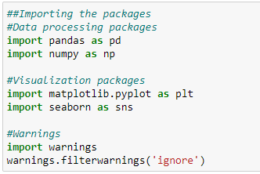
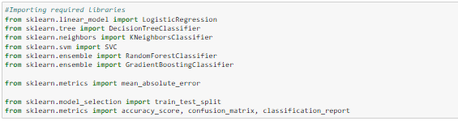
Import Libraries

Slide 6
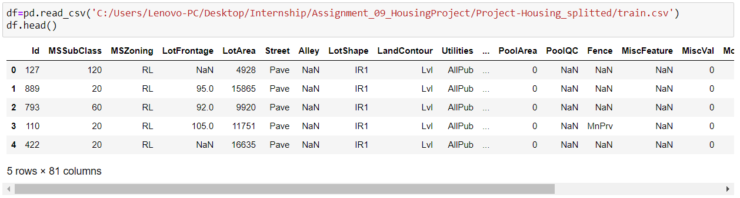
Import dataset
Dataset is having both numeric and categorical type columns. Also we can see there are null and invalid values in the dataset that needs to be treated.

Slide 7
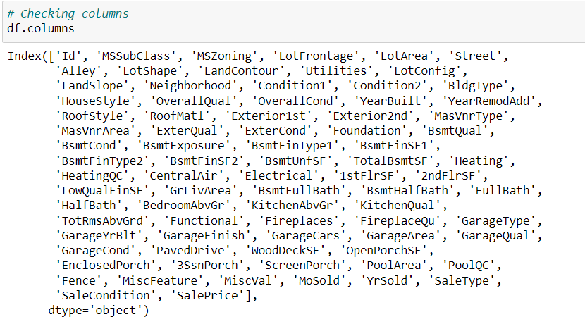
Checking column details
Columns names are displayed where ‘SalePrice' is the target variable and all other are independent variables.

Slide 8
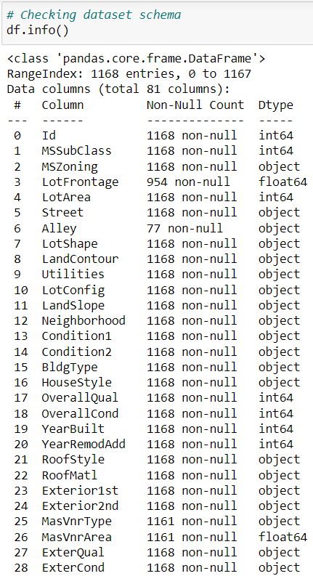
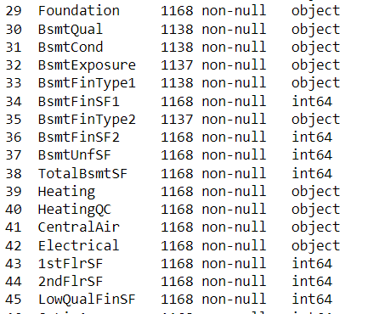
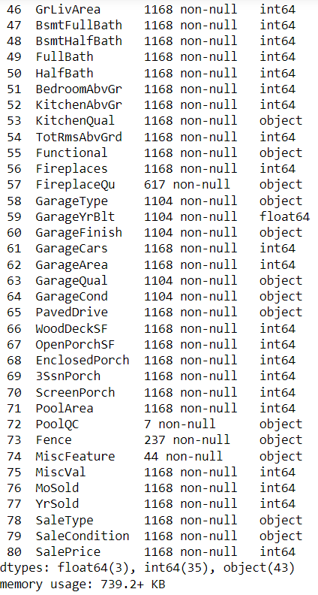
Checking for dataset information
It gives additional information regarding the dataset like RangeIndex, Data columns, datatypes.
We can see there are null values in the dataset. Columns 'PoolQC', 'Fence', 'MiscFeature' are having None in more than half of the data, hence these could not contribute well in model learning.
Column 'GarageYrBlt' is having year values but in float format so datatype conversion is required here.

Slide 9
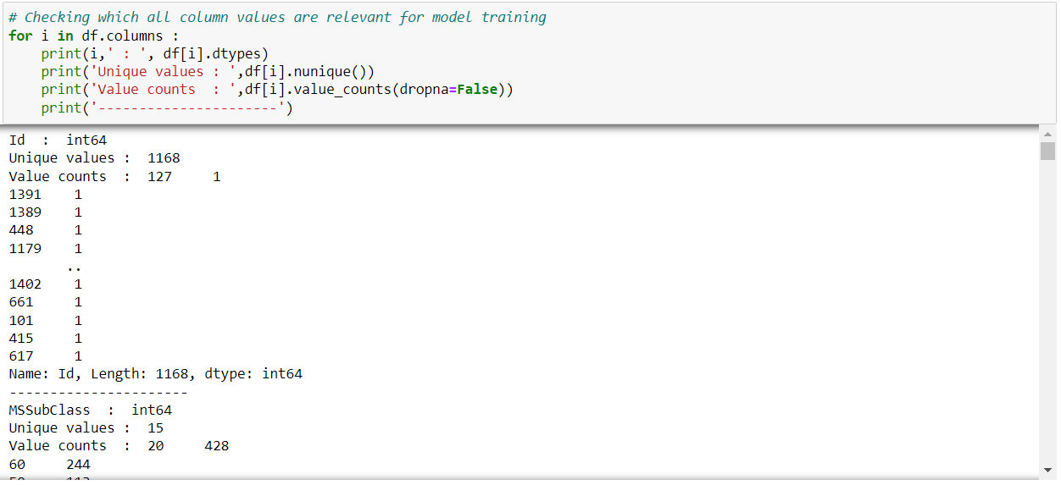
Data Preprocessing
We have checked number of unique values in all the columns. 'Id' column has just unique values in all 1168 records. Column 'Alley' has 1091 NA values which means No alley access hence it needs to be replaced. Column 'MasVnrType' is having more than half of total rows having Masonry veneer type as None. 'Utilities' column has just 1 value i.e. 'AllPub' in all 1168 data records. Column 'MasVnrArea' has more than half records with Masonry veneer area in square feet as 0.0 which is an invalid value. Column 'PoolArea' s having majority of values as 0 and a few other values with just 1-1 counts, hence irrelevant.
Therefore, these columns will not contribute much in model learning.

Slide 10
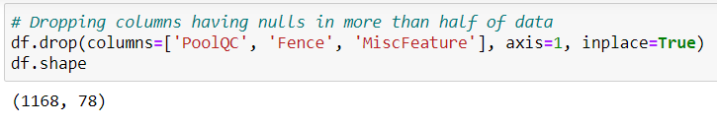
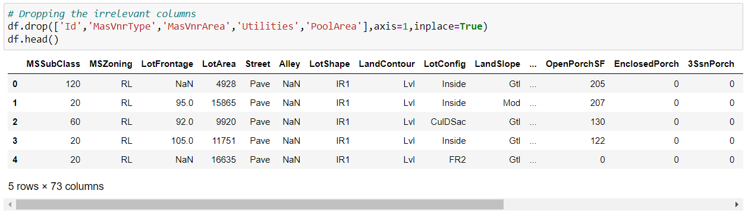
Deleting unnecessary columns that are not contributing much
Dropped the irrelevant columns and proceeding for further analysis.

Slide 11
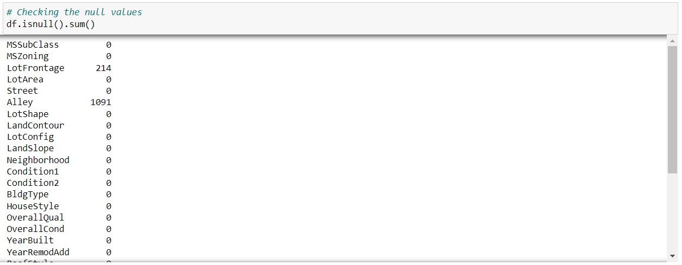
Checking for the null values
There are null values in the dataset columns 'LotFrontage', 'Alley', 'BsmtQual', 'BsmtCond', 'BsmtExposure', 'BsmtFinType1', 'BsmtFinType2', 'FireplaceQu', 'GarageType', 'GarageYrBlt', 'GarageFinish', 'GarageQual', 'GarageCond', . 'Alley' as NA means No alley access, hence ir needs to be replaced with some other value.

Slide 12
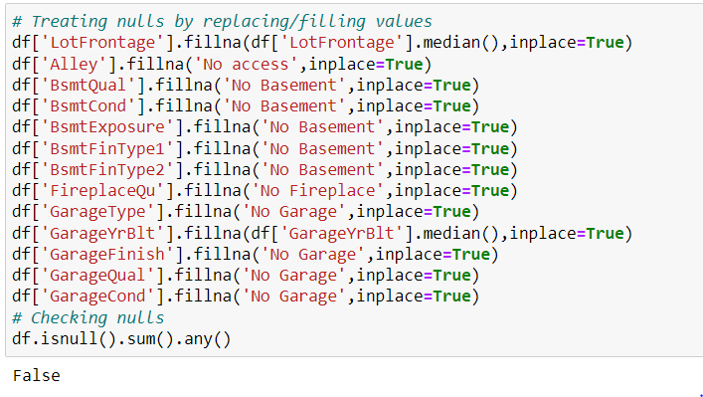
Treating null values by replacing the values
Replaced the nulls with relevant values w.r.t. different columns and there are no more null values in the dataset.

Slide 13
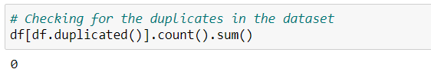
Checking and treating the duplicates in dataset
There are no duplicate values in the dataset.

Slide 14
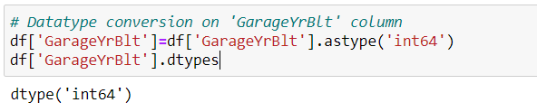
Datatype conversion on 'GarageYrBlt' column
Data type transformation is done for column 'GarageYrBlt’ which contains
Year values but was in float data type.

Slide 15
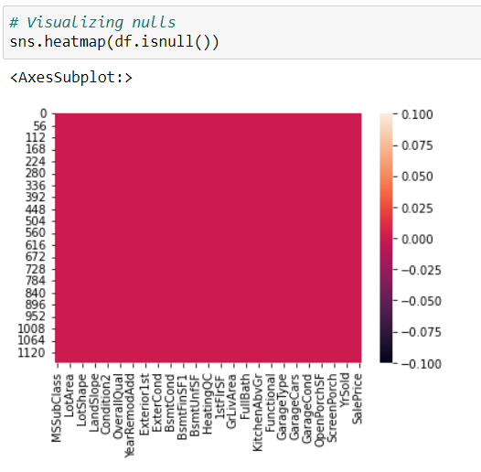
Exploratory Data Analysis and Visualizations
Checking for null values in the dataset
Heatmap showing no null values are present in the dataset.

Slide 16
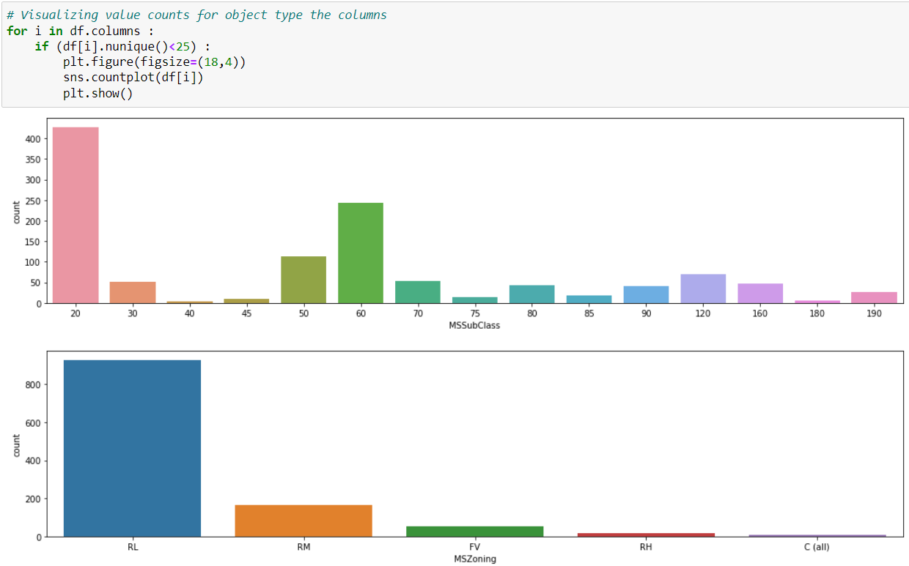
Checking for the value counts using count plot

Slide 17
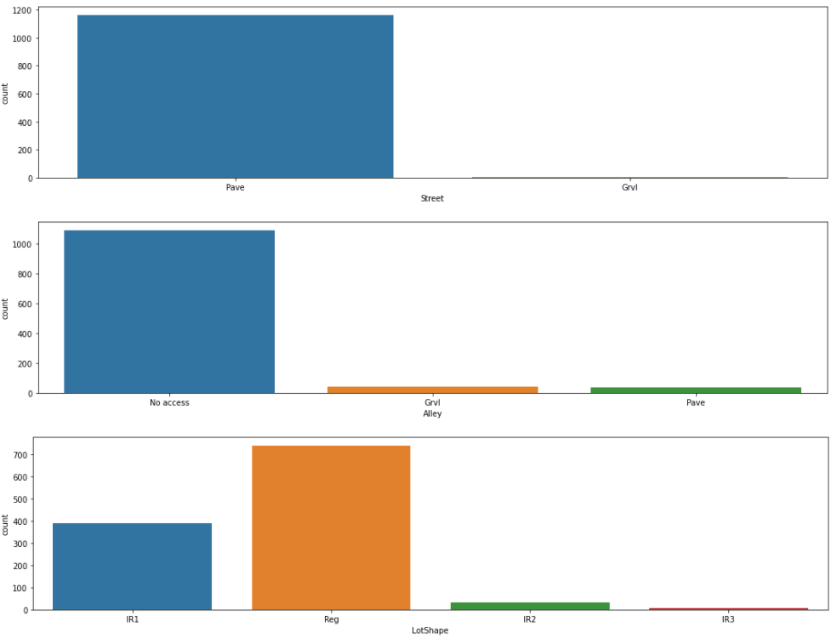
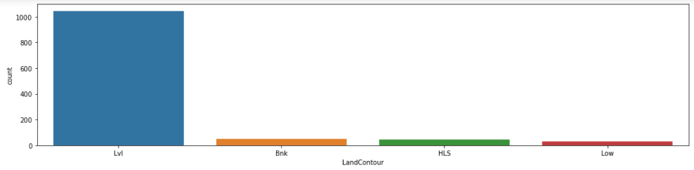

Slide 18
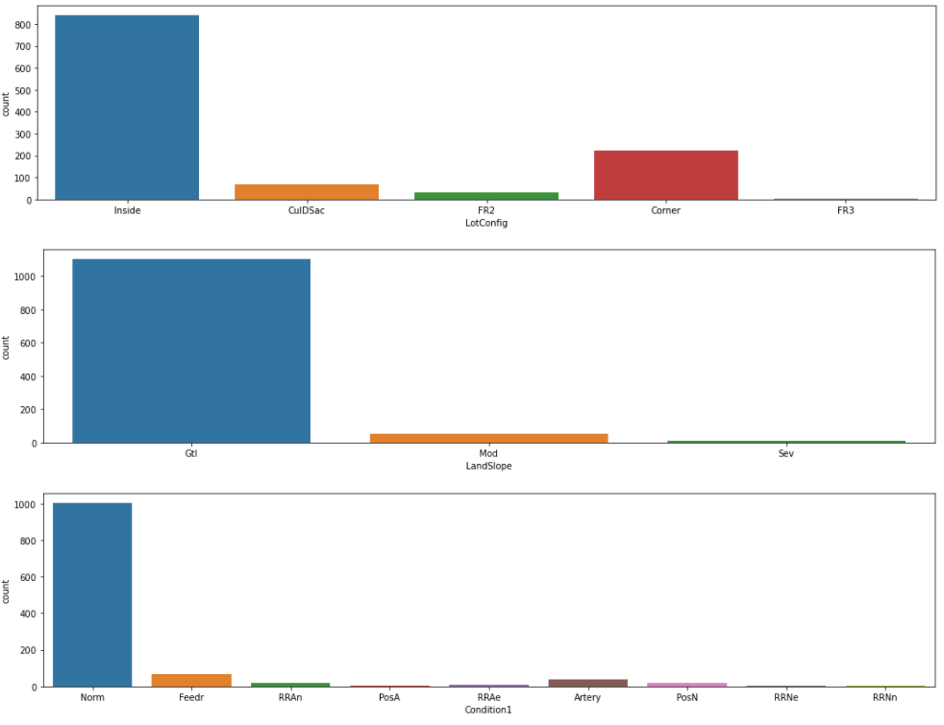
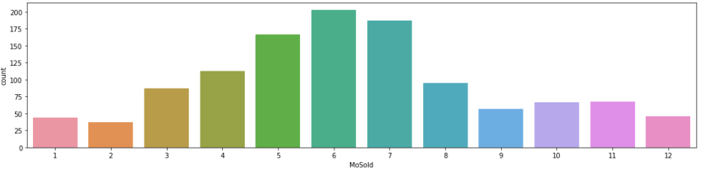

Slide 19
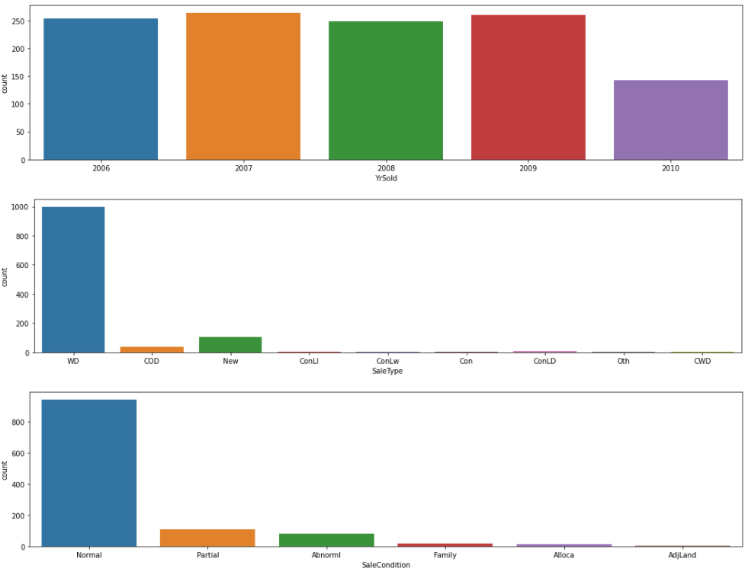
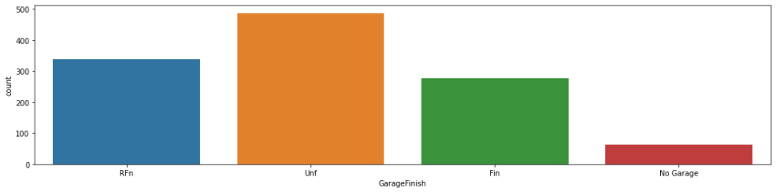

Slide 20
Inferences of the count plots
MSSubClass as 20 (1-STORY 1946 & NEWER ALL STYLES) is highly preferred followed by 60(2-STORY 1946 & NEWER). MSZoning is highly in RL (Residential Low Density) and least in C(all) Commercial. Street is majorly Pave. Houses with No alley access are in majority and other options are in similar counts. LotShape as Reg (Regular) is leading all others. LAndContour as Lvl (Near Flat/Level) is highly preferred. LotConfig as Inside is in majority and FR3 Frontage on 3 sides of property is least in count. Gtl-Gentle in LandSlope is mostly preferred. Condition 1 as Normal is in majority others are very less comparatively and same for Condition 2 as well. BldgType Type of dwelling as 1Fam Single-family Detached is leading all others. HouseStyle as 1Story One story is highly preferred followed by 2Story Two story and 1.5Fin One and one-half story: 2nd level finished. OverallQual is mostly given Rates to overall material and finish of the house as Average followed by Above Average, Good, Very Good. OverallCond: Rates the overall condition of the house is Average for most of the houses. RoofStyle Gable is in majority among all other options. RoofMatl is highly chosen as CompShg Standard (Composite) Shingle. Exterior covering on house Exterior1st and Exterior2nd as VinylSd Vinyl Siding is highly preferred. ExterQual: Evaluates the quality of the material on the exterior, ExterCond: Evaluates the present condition of the material on the exterior and BsmtCond: Evaluates the general condition of the basement are rated as Average/Typical majorly. Type of foundation of houses are in CBlock Cinder Block and PConc Poured Contrete majorly. BsmtQual Evaluates the height of the basement is mostly Typical (80-89 inches) followed by Good (90-99 inches) and very few houses have no basement. BsmtExposure: Refers to walkout or garden level walls and majority of houses have No Exposure and least have No Basement. BsmtFinType1: Rating of basement finished area is Unfinshed for highest number of houses folloed by Good Living Quarters. BsmtFinType2: Rating of basement finished area (if multiple types) is highest for Unfinshed. Type of heating is highly by GasA (Gas forced warm air furnace). HeatingQC: Heating quality and condition is overall Excellent. CentralAir: Central air conditioning is there in majority of houses. Electrical: Electrical system SBrkr (Standard Circuit Breakers & Romex) is leading all others. LowQualFinSF: Low quality finished square feet (all floors) is 0 in high number. 3SsnPorch: Three season porch area in square feet and MiscVal: $Value of miscellaneous feature is 0 in majority.
BsmtFullBath: Basement full bathrooms are mostly 0 followed by 1. BsmtHalfBath: Basement half bathrooms are mostly 0 in count. FullBath: Full bathrooms above grade are 2 in most of the house data followed by 1. HalfBath: Half baths above grade are 0 in most of the houses, followed by 1 and least have 2. BedroomAbvGr are 3 in majority. KitchenAbvGr is 1 in majority. KitchenQual: Kitchen quality is highly Typical/Average followed by Good. TotRmsAbvGrd: Total rooms above grade (does not include bathrooms) are 6 followed by 7 then 5 and then 8. Functional: Home functionality (Assume typical unless deductions are warranted) is mostly Typical Functionality. Fireplaces: Number of fireplaces are 0 followed by 1 in majority of houses. FireplaceQu: Fireplace quality is majorly good in the houses where fireplaces are available but most houses have No Fireplace. GarageType: Garage location is mostly Attached to home followed by Detached from home. GarageFinish: Interior finish of the garage is majorly Unfinished followed by Rough Finished and then comes Finished least have No Garage. GarageCars: Size of garage in car capacity is mostly 2. GarageQual: Garage quality and GarageCond: Garage condition are mostly Typical/Average. PavedDrive: Paved driveway are mostly Paved. MoSold: Month Sold (MM) has highest count in 6 then 7 then 5. YrSold: Year Sold (YYYY) is highest in 2009.

Slide 21
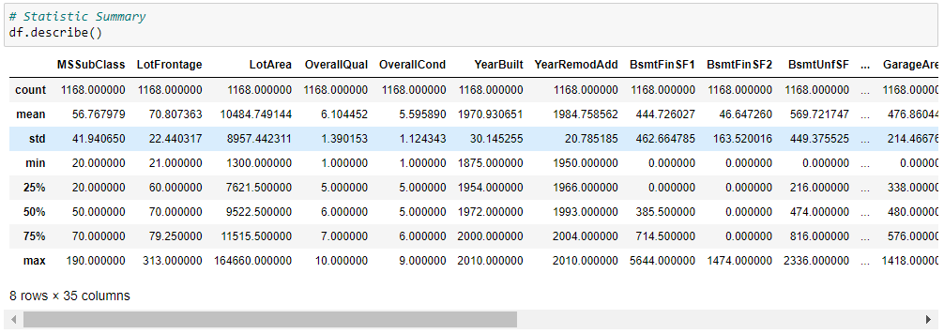
Statistic Summary
Column MSSubClass has range from 20 to 190, LotFrontage ranges from 21 to 313, LotArea are from 1300 and 164660, OverallQual has values from 1-10. OverallCond has values from 1-9, YearBuilt has years from 1875 to 2010. YearRemodAdd has years from 1950-2010. BsmtFinSF1 ranges from 0 to 5644. BsmtUnfSF ranges from 0 to 1474. BsmtUnfSF ranges from 0 to 2336. GarageArea ranges from 0-1418, WoodDeckSF ranges from 0-857, OpenPorchSF has values from 0-547, EnclosedPorch has values from 0 to 552, 3SsnPorch contains values from 0-508, ScreenPorch has values from 0-480, YrSold has years from 2006 to 2010, SalePrice has values starting from 34900 to 755000 and so on..
MSSubClass,LotArea,BsmtFinSF1,BsmtFinSF2,BsmtUnfSF,WoodDeckSF,OpenPorchSF,EnclosedPorch,SalePrice etc has mean>median i.e. right skewed. GarageArea has mean<median i.e. left skewed.
Standard deviation is high for many columns. Difference between 75 percentile and max value is high for many columns hence, outliers need to be treated.

Slide 22
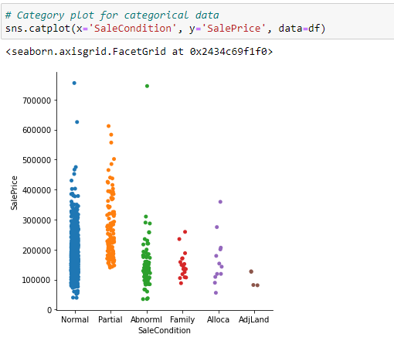
Category plot between SaleCondition and SalePrice
Houses are majorly of Normal Sale Condition and a few values are there for Adjoining Land Purchase. Starting and overall Sale Price is high for Partial Home not completed when last assessed (associated with New Homes) Sale Condition houses.

Slide 23
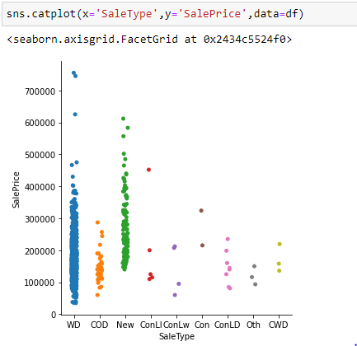
Category plot between SaleType and SalePrice
Sale Type WD: Warranty Deed-Conventional has majority of data and Sale Price in this is lowest and highest both comparatively. Next New Home just constructed and sold has good amount of data with higher starting price w.r.t others.

Slide 24
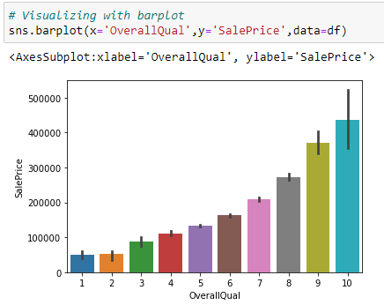
Barplot between OverallQual and SalePrice
Sale Price increases with increase in Rates the overall material
and finish of the house.

Slide 25
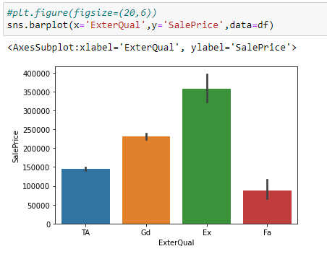
Barplot between ExterQual and SalePrice
Sale Price is highest for Excellent ExterQual: Evaluates the quality of the material on the exterior and lowest for Fair ExterQual.

Slide 26
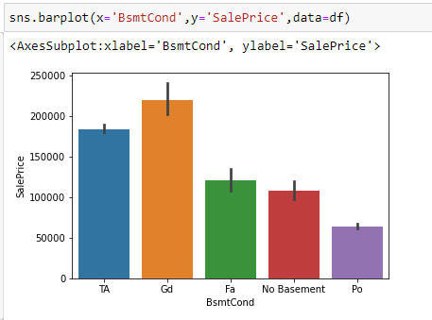
Barplot between BsmtCond and SalePrice
SalePrice is highest for Good general condition of the basement and lease for poor general condition of the basement.

Slide 27
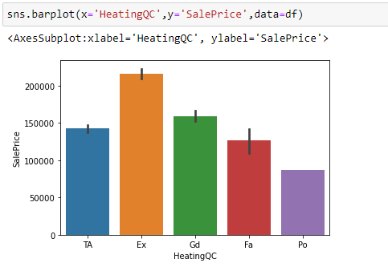
Barplot between HeatingQC and SalePrice
SalePrice is highest for Excellent Heating quality and condition and lowest for Poor Heating quality and condition.

Slide 28
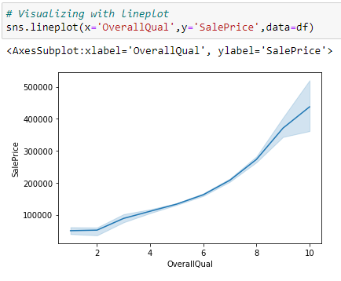
Lineplot showing relation between OverallQual and SalePrice
SalePrice increases with increased rating of overall material and finish of the house

Slide 29
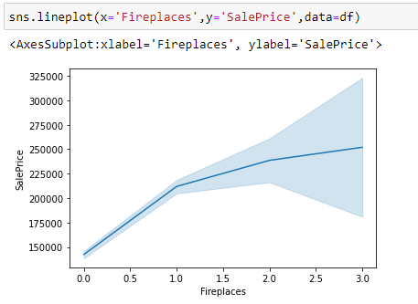
Lineplot showing relation between Fireplaces and SalePrice
With increase in Fireplaces, SalePrice also increases.

Slide 30
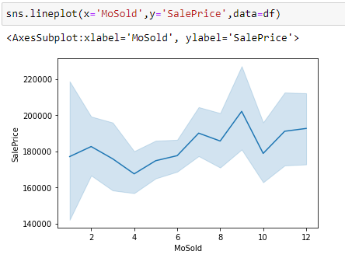
Lineplot showing relation between MoSold and SalePrice
SalePrice is highest in 9th month and lowest in April.

Slide 31
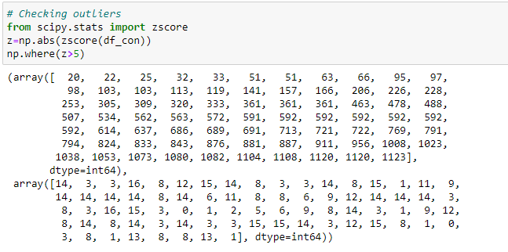
Checking for outliers
Output showing there are presence of outliers in the columns.

Slide 32
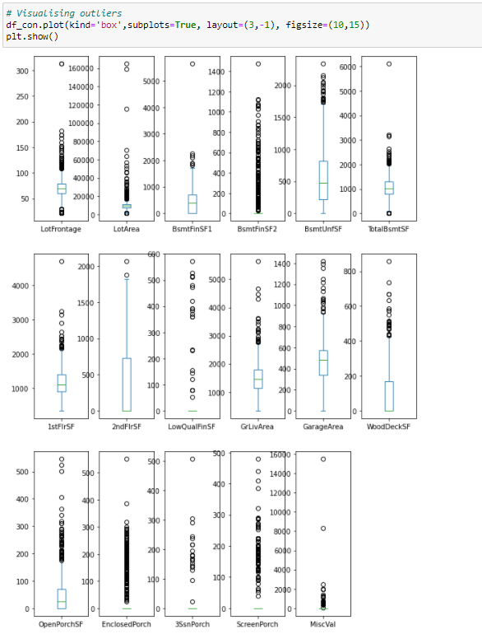
Visualizing outliers
Outliers are present in columns but these columns have impact on target column hence we will not remove these outliers.

Slide 33
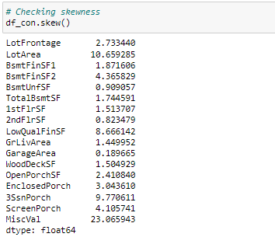
Checking skewness
Skewness is present in the dataset as acceptable range is +/-0.5, but in case of high skewness we can change the threshold as per the kind of data distribution in particular column.

Slide 34
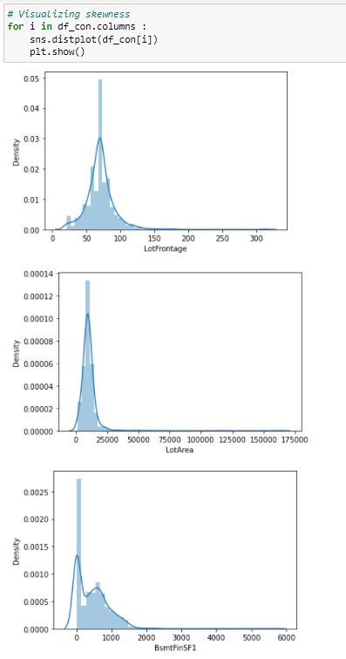
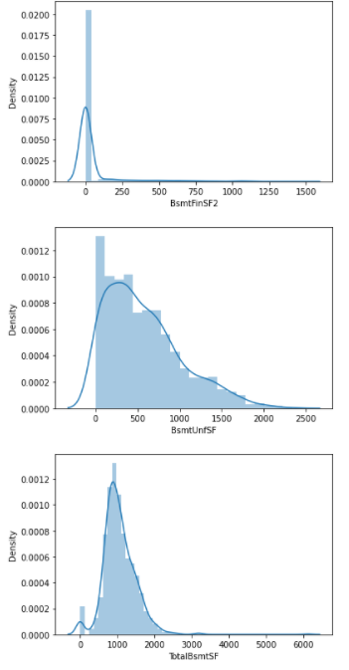
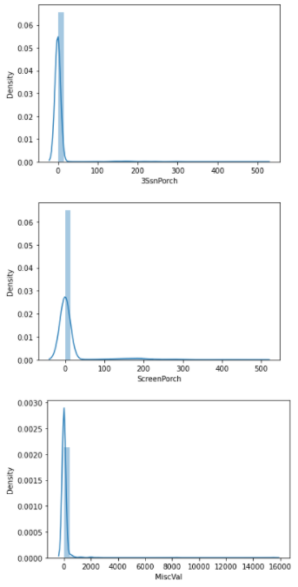
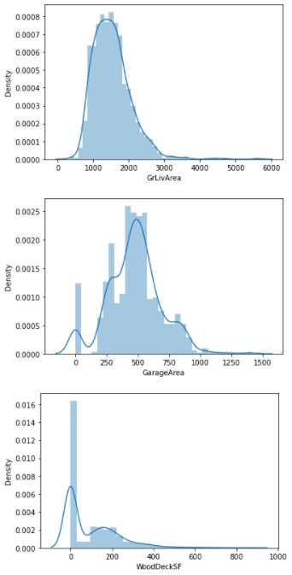
Visualizing Skewness
We need to treat skewness in columns considering a threshold value for skewness as +/-0.5 (we will not transform ‘Price’ column, since it is our target variable).

Slide 35
Data Cleaning
Data Cleaning means the process of identifying the incorrect, incomplete, inaccurate, irrelevant or missing part of the data and then modifying, replacing or deleting them according to the necessity. Data cleaning is considered a foundational element of the basic data science. The process includes :
Removing outliers
Removing skewness

Slide 36
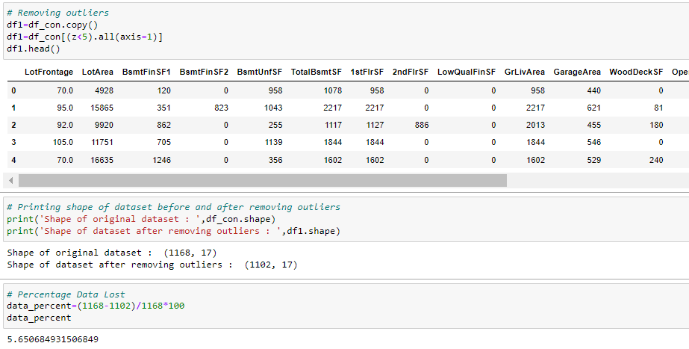
Removing outliers
Outliers are treated and approx 5.7% data is lost after removing the outliers.

Slide 37
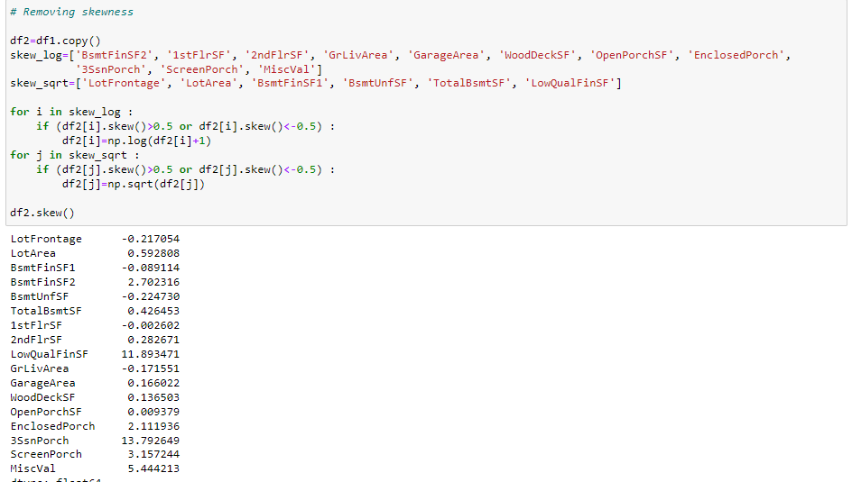
Removing Skewness
Removed skewness from the column by applying transformations based on the kind of data distribution.

Slide 38
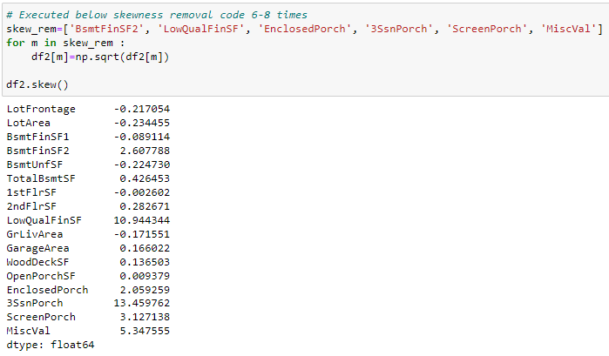
Removed skewness from all columns but in columns 'BsmtFinSF2', 'LowQualFinSF', 'EnclosedPorch', '3SsnPorch', 'ScreenPorch', 'MiscVal' no significant change is seen on further applying transformations due to the kind of data distribution. Hence we can consider the present values as skewness threshold.

Slide 39
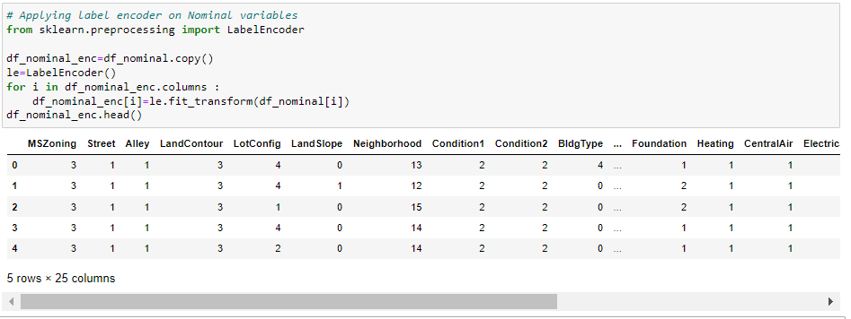
Data Transformation (Encoding categorical columns)
Categorical columns with object data types are now encoded.

Slide 40
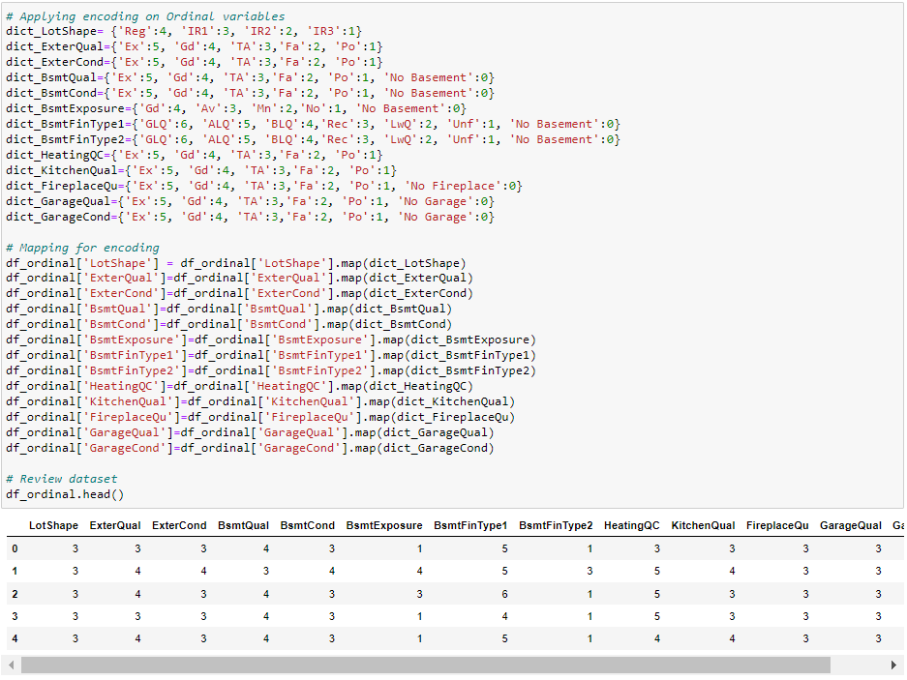
Categorical columns with numeric data types are now encoded.

Slide 41
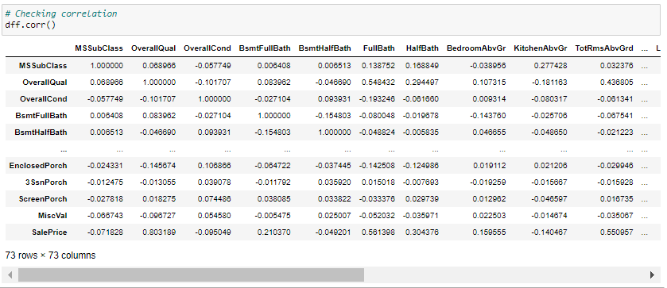
Checking Correlation

Slide 42
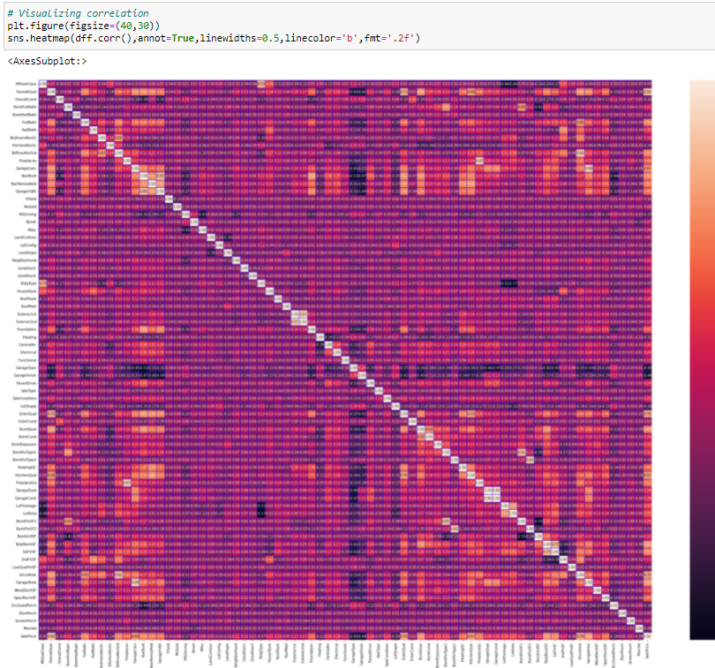
Visualizing correlation
EnclosedPorch has good correlation with YearBuilt, GarageYrBlt. OpenPorchSF has good correlation with OverallQual, EnclosedPorch has good correlation with YearBuilt, GarageYrBlt. OpenPorchSF has good correlation with OverallQual, FullBath, HalfBath, GarageCars, YearBuilt, TotRmsAbvGrd, GarageYrBlt, ExterQual, BsmtQual,GarageArea.

Slide 43
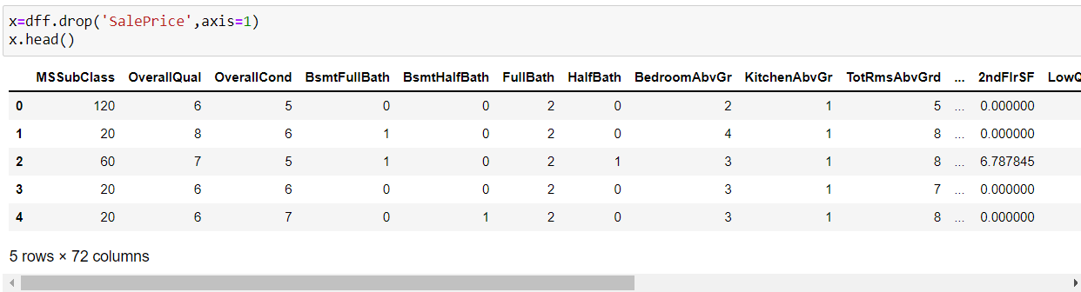
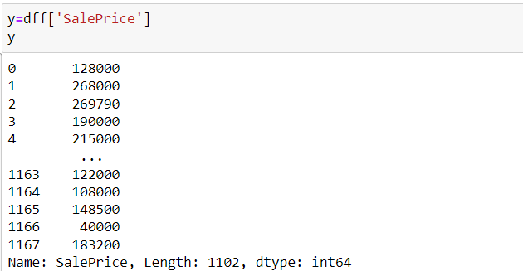
Dividing dataset in x and y

Slide 44
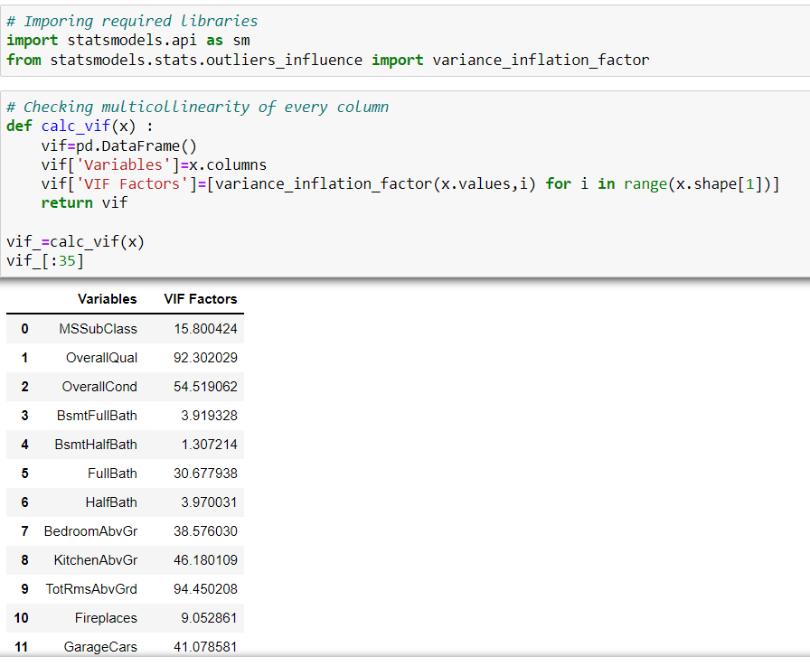
Multicollinearity with VIF

Slide 45
Inference
In dataset, among multicolinear columns the features that are contributing less to the output variable can be dropped. We can drop 1-2 columns showing high colinearity but not all as it impacts the output.
Machine learning needs refined dataset. It needs only those columns that are highly contributing to the output. Clean data for which EDA is used. This is for better learning and prediction of data by models.
Once refining is done we'll do Standard Scaler to make all data scaled to mean=0 and std.dev.=+-1, so that prediction could be nearby.

Slide 46
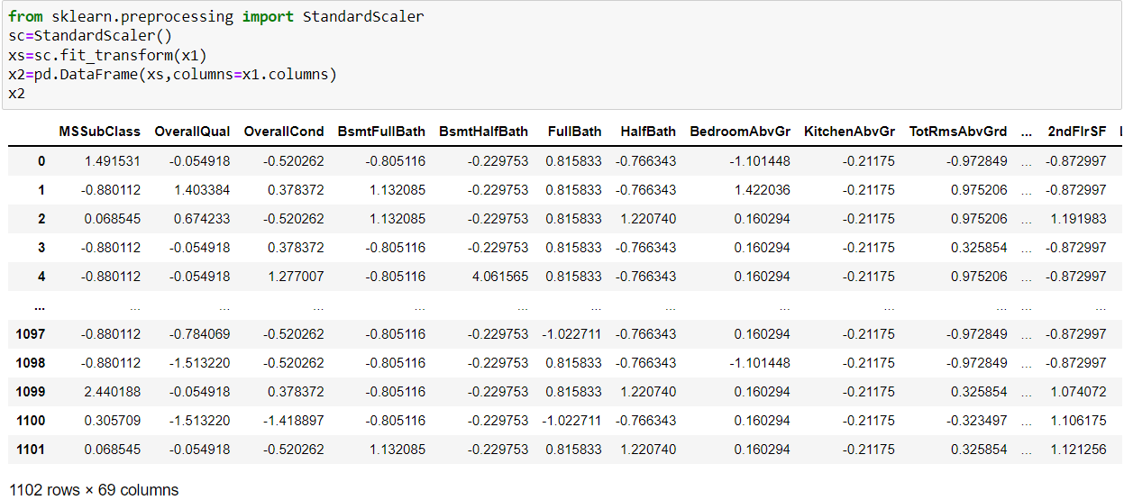
Scaling : Standard Scaler / Min-Max Scaler
Scaling is done for making data points generalized so that the distance between them will be lower.

Slide 47

Find best random state for Train-Test Split
Looking at the training & testing accuracies, lets take 0 as our best random state.

Slide 48

Finding the best algorithm
Model Building
We are using 4-5 models for training and testing.

Slide 49

Accuracy and evaluation metrics of the models used
GradientBoostingRegressor has the highest accuracy but let's go for cross validation for all the models used.

Slide 50

Cross validation
Looking at difference of accuracy and cv mean, LinearRegression, RandomForestRegressor and GradientBoostingRegressor are showing good accuracy and almost similar difference between accuracy and cv mean.

Slide 51

Hyper parameter Tuning
Using hyper parameter tuning for better accuracy and to avoid over fitting issues with best parameters on selected model.
We are getting model accuracy as approx 92% and cv mean as approx 89% for model GradientBoostingRegressor, and it shows our model is performing good.

Slide 52


Saving the model and checking accuracy
Saving the model selected using pickle in pickle file to convert it into byte stream. This is called Serialization.

Slide 53

Conclusion

Slide 54
Conclusion
We are getting good accuracy of training and testing of the given dataset after cleaning the data using GradientBoostingRegressor() for model development and evaluation.
Data science comes as a very important tool to solve problems in the domain to help the companies increase their overall revenue, profits, improving their marketing strategies and focusing on changing trends in house sales and purchases. Predictive modeling, Market mix modeling, recommendation systems are some of the machine learning techniques used for achieving the business goals for housing companies.
The proposed system will help to determine the house prices accurately.

